Slide 1


Quantum Error Correcting
Professor | : | 김성환 (Kim, Sunghwan)
Student | : | Nguyen Manh Duc
ID | : | 20155290

Slide 2
Outline
Basic Quantum circuits
Quantum Error Correction
Notes:
Mechanism: cơ chế

Slide 3
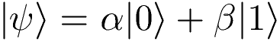
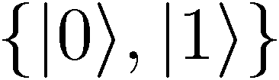
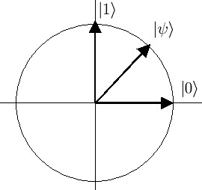
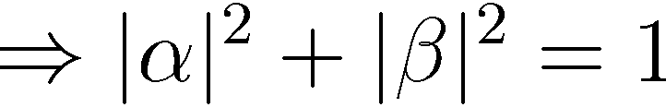
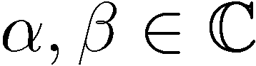
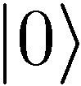
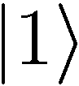
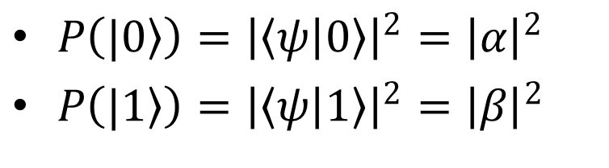
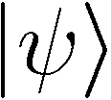
Basic Quantum circuits Short of quantum bit
Computational basis
Measurement
non-deterministic collapse
$P\left(|\left.0\right\rangle \right)={\left|\left\langle ψ | 0\right\rangle \right|}^{2}={\left|α\right|}^{2}$
$P\left(|\left.1\right\rangle \right)={\left|\left\langle ψ | 1\right\rangle \right|}^{2}={\left|β\right|}^{2}$
Notes:
-A register with one qubits can be in a supersession of 2 basic: Dirac 0; Dirac 1. And alpha, beta must satisfy the condition:
-So It will non-deterministic collapse into Dirac 0 and Dirac 1 with probability in Dirac 0: module square of bra PHI ket 0 equals square of module alpha.

Slide 4
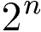
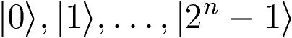
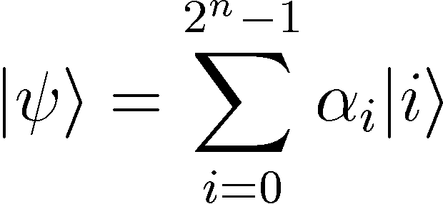
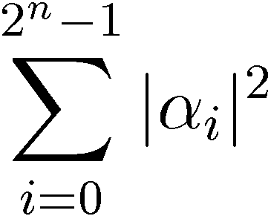
Basic Quantum circuits Short of quantum bit
2-qubit:
n-qubit
states
Notes:
Decimal integer
Binary integer

Slide 5
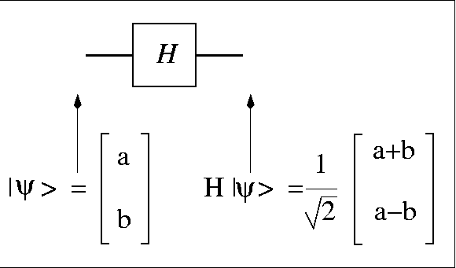
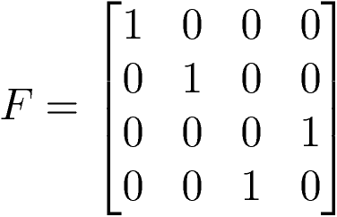

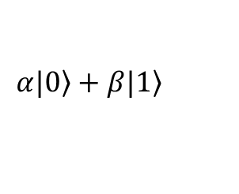
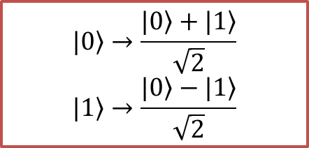
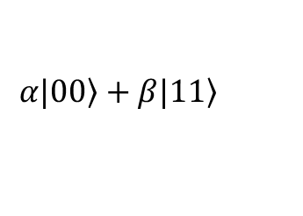
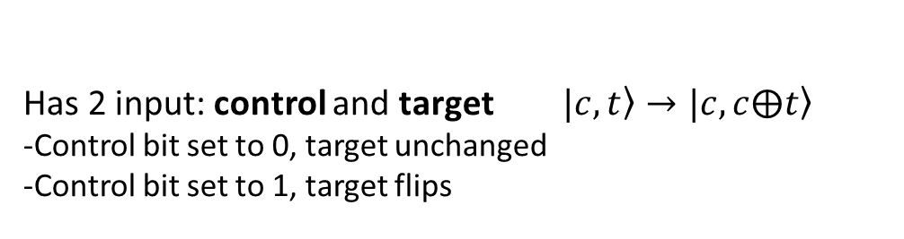
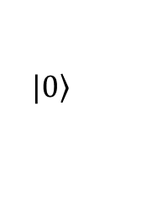
Basic Quantum circuits Basic gate
Hadamard gate:
$$|\left.0\right\rangle →\frac{|\left.0\right\rangle +|\left.1\right\rangle }{\sqrt{2}}$$
$$|\left.1\right\rangle →\frac{|\left.0\right\rangle −|\left.1\right\rangle }{\sqrt{2}}$$
Control-NOT gate:
Has 2 input: control and target $\left.|c,t\right\rangle →\left.|c,c⨁t\right\rangle$
-Control bit set to 0, target unchanged
-Control bit set to 1, target flips
$$\left.α|0\right\rangle +β\left.|1\right\rangle$$
$$\left.α|00\right\rangle +β\left.|11\right\rangle$$
$$\left.|0\right\rangle$$

Slide 6
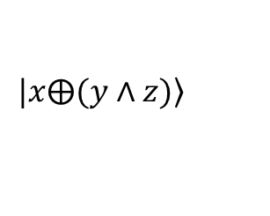
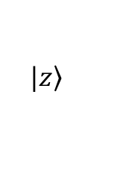
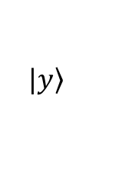
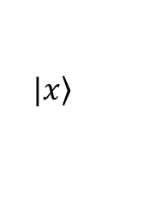
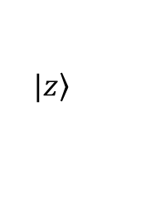
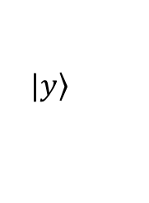
Basic Quantum circuits Basic gate
2 Controlled gate:
Input | Output
000 | 000
001 | 001
010 | 010
011 | 111
100 | 100
101 | 101
110 | 110
111 | 011
$$|\left.x\right\rangle$$
$$|\left.x⨁(y∧z)\right\rangle$$
$$|\left.y\right\rangle$$
$$|\left.y\right\rangle$$
$$|\left.z\right\rangle$$
$$|\left.z\right\rangle$$

Slide 7
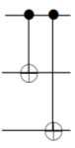
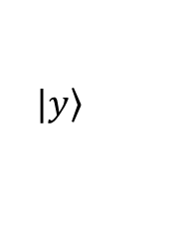
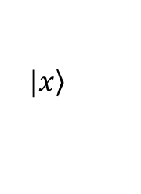
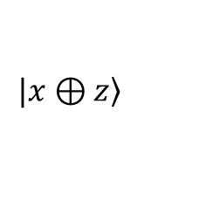
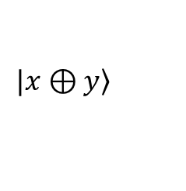
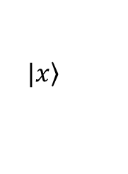
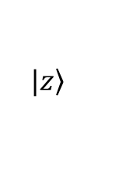
Basic Quantum circuits Basic gate
Encoding gate:
Input | Output
000 | 000
001 | 001
010 | 010
011 | 011
100 | 111
101 | 110
110 | 101
111 | 100
$$|\left.x\right\rangle$$
$$|\left.x\right\rangle$$
$$|\left.y\right\rangle$$
$$|\left.x⊕y\right\rangle$$
$$|\left.z\right\rangle$$
$$|\left.x⊕z\right\rangle$$

Slide 8
Outline
Basic Quantum circuits
Quantum Error Correction
Three Qubit Bit Flip Code
Three Qubit Phase Flip Code
Notes:
Mechanism: cơ chế

Slide 9
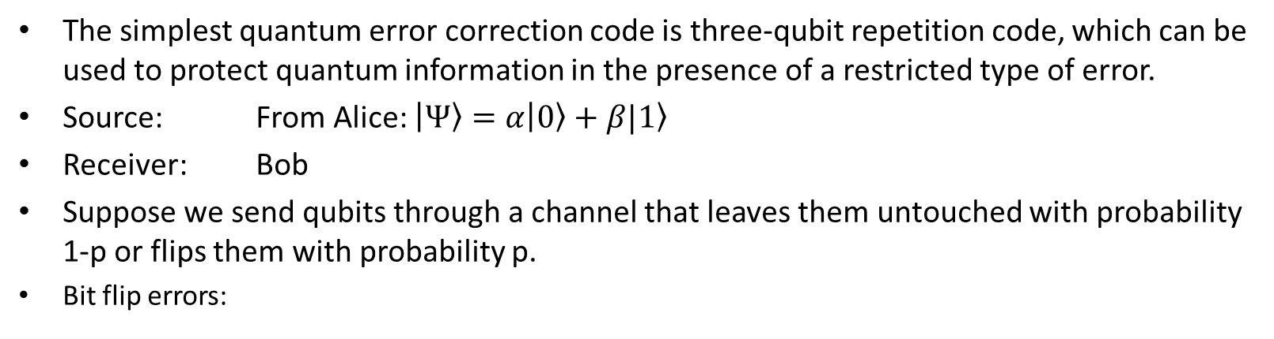
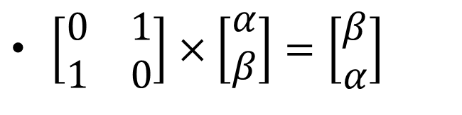
Quantum Error Correction The three Qubit Bit Flip Code
The simplest quantum error correction code is three-qubit repetition code, which can be used to protect quantum information in the presence of a restricted type of error.
Source: From Alice: $\left|\left.Ψ\right\rangle =α\right|\left.0\right\rangle +β|\left.1\right\rangle$
Receiver: Bob
Suppose we send qubits through a channel that leaves them untouched with probability 1-p or flips them with probability p.
Bit flip errors:
X matric
$\left[\begin{matrix}0 & 1 \\ 1 & 0\end{matrix}\right]×\left[\begin{matrix}α \\ β\end{matrix}\right]=\left[\begin{matrix}β \\ α\end{matrix}\right]$

Slide 10
Quantum Error Correction The three Qubit Bit Flip Code
(3,1) repetition code circuit:
Encoding
Channel noise
Decoding
α|0⟩ + β|1⟩
α|0⟩ + β|1⟩
e
|0⟩
|s_{e}⟩
syndrome of the error
|0⟩
encode
error
decode
Notes:
Fault-tolerant: khả năng chịu lỗi

Slide 11
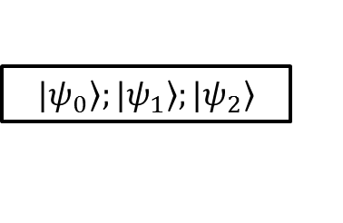
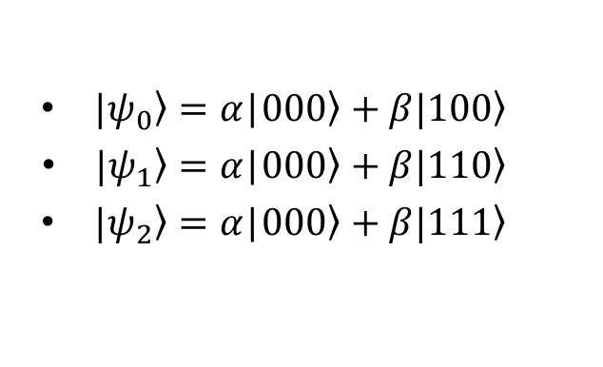
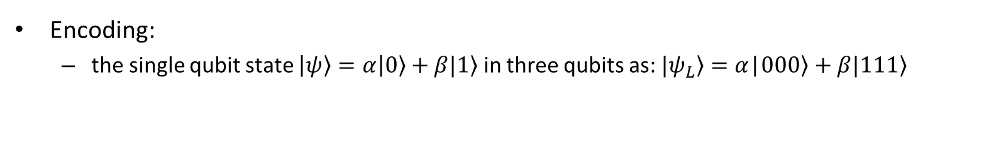
Quantum Error Correction The three Qubit Bit Flip Code
Encoding:
the single qubit state $\left|\left.ψ\right\rangle =α\right|\left.0\right\rangle +β|\left.1\right\rangle$ in three qubits as: $\left.|ψ_{L}\right\rangle =α$|$00\left.0\right\rangle +β|11\left.1\right\rangle$
$$|\left.ψ_{0}\right\rangle ;|\left.ψ_{1}\right\rangle ;|\left.ψ_{2}\right\rangle$$
$|\left.ψ_{0}\right\rangle =α\text{|}00\left.0\right\rangle +β|10\left.0\right\rangle$
$|\left.ψ_{1}\right\rangle =α\text{|}00\left.0\right\rangle +β|1\left.10\right\rangle$
$|\left.ψ_{2}\right\rangle =α\text{|}00\left.0\right\rangle +β|11\left.1\right\rangle$

Slide 12
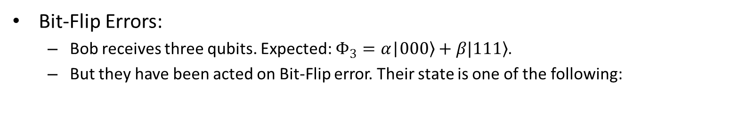
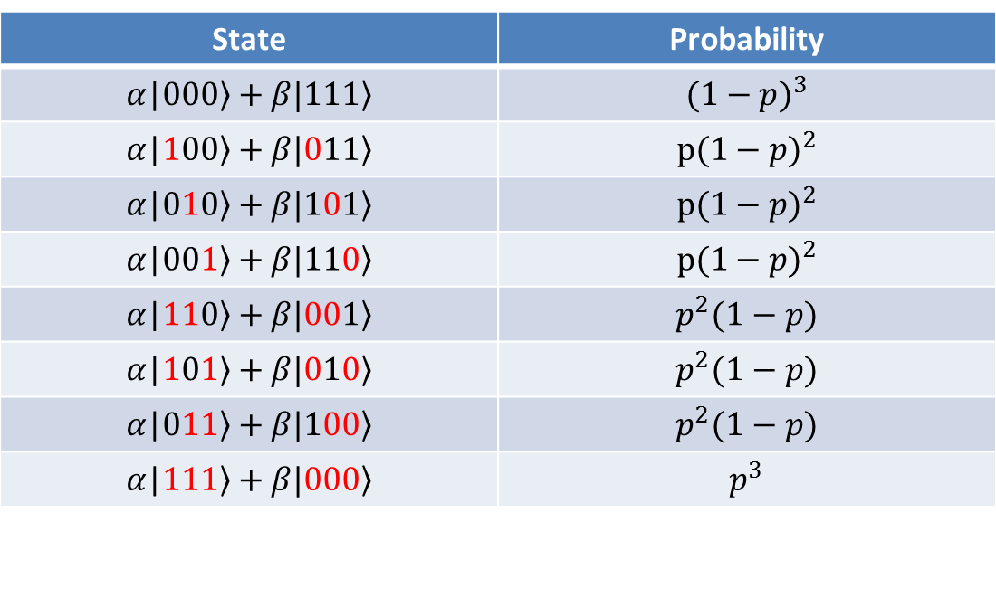
Quantum Error Correction The three Qubit Bit Flip Code
Bit-Flip Errors:
Bob receives three qubits. Expected: $Φ_{3}=α\text{|}00\left.0\right\rangle +β|11\left.1\right\rangle$.
But they have been acted on Bit-Flip error. Their state is one of the following:
State | Probability
$$α\text{|}00\left.0\right\rangle +β|11\left.1\right\rangle$$ | $${(1−p)}^{3}$$
$$α\text{|}10\left.0\right\rangle +β|01\left.1\right\rangle$$ | $$p{(1−p)}^{2}$$
$$α\text{|}01\left.0\right\rangle +β|10\left.1\right\rangle$$ | $$p{(1−p)}^{2}$$
$$α\text{|}00\left.1\right\rangle +β|11\left.0\right\rangle$$ | $$p{(1−p)}^{2}$$
$$α\text{|}11\left.0\right\rangle +β|00\left.1\right\rangle$$ | $$p^{2}(1−p)$$
$$α\text{|}1\left.01\right\rangle +β|01\left.0\right\rangle$$ | $$p^{2}(1−p)$$
$$α\text{|}0\left.11\right\rangle +β|1\left.00\right\rangle$$ | $$p^{2}(1−p)$$
$$α\text{|}\left.111\right\rangle +β|\left.000\right\rangle$$ | $$p^{3}$$

Slide 13
Quantum Error Correction The three Qubit Bit Flip Code
Decoding:
Solve problem with 1 bit flipped.
Notes:
Fault-tolerant: khả năng chịu lỗi

Slide 14
Quantum Error Correction The three Qubit Bit Flip Code
Decoding:
Last 2 qubits called the syndrome and tell us the type that occurs:
Syndrom as a result of error that happened
Syndrome | Error
00 | No error
01 | 3rd qubit flipped
10 | 2nd qubit flipped
11 | 1st qubit flipped
Notes:
Fault-tolerant: khả năng chịu lỗi

Slide 15
Quantum Error Correction The three Qubit Bit Flip Code
Decoding:
Correction by:
Notes:
Fault-tolerant: khả năng chịu lỗi

Slide 16
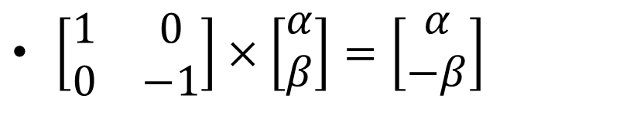
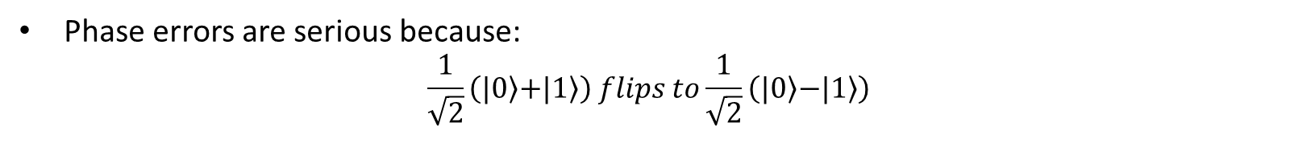
Quantum Error Correction The three Qubit Phase-Flip Code
Phase errors:
Z matric
$\left[\begin{matrix}1 & 0 \\ 0 & −1\end{matrix}\right]×\left[\begin{matrix}α \\ β\end{matrix}\right]=\left[\begin{matrix}α \\ −β\end{matrix}\right]$
Phase errors are serious because:
$$\frac{1}{\sqrt{2}}\left(|\left.0\right\rangle \left.+|1\right\rangle \right) flips to\frac{1}{\sqrt{2}}\left(|\left.0\right\rangle \left.−|1\right\rangle \right)$$
Idea to correct:
Pauli Z

Slide 17
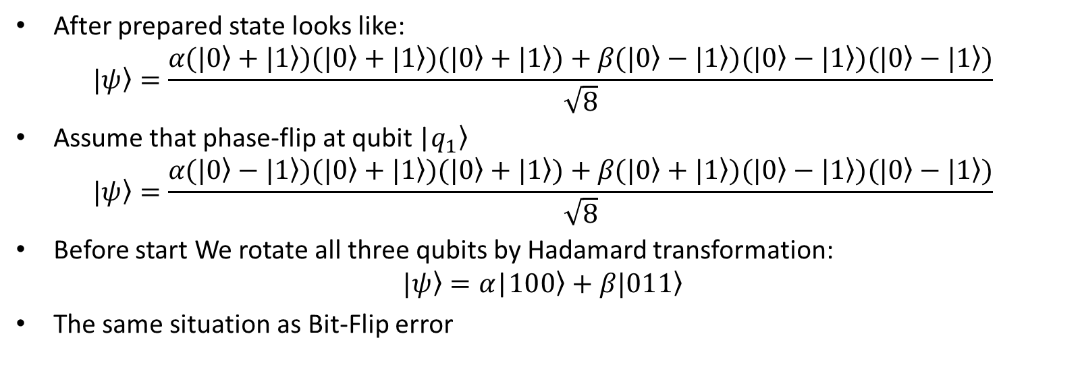
Quantum Error Correction The three Qubit Phase-Flip Code
α|0⟩ + β|1⟩
H
e
H
α|0⟩ + β|1⟩
|0⟩
H
H
|s_{e}⟩
|0⟩
H
H
encode
error
decode
After prepared state looks like:
$$\left.|ψ\right\rangle =\frac{α\text{(}\left.|0\right\rangle +\left.|1\right\rangle )\text{(}\left.|0\right\rangle +\left.|1\right\rangle )\text{(}\left.|0\right\rangle +\left.|1\right\rangle )+β\text{(}\left.|0\right\rangle −\left.|1\right\rangle )\text{(}\left.|0\right\rangle −\left.|1\right\rangle )\text{(}\left.|0\right\rangle −\left.|1\right\rangle )}{\sqrt{8}}$$
Assume that phase-flip at qubit |$\left.q_{1}\right\rangle$
$$\left.|ψ\right\rangle =\frac{α\text{(}\left.|0\right\rangle −\left.|1\right\rangle )\text{(}\left.|0\right\rangle +\left.|1\right\rangle )\text{(}\left.|0\right\rangle +\left.|1\right\rangle )+β\text{(}\left.|0\right\rangle +\left.|1\right\rangle )\text{(}\left.|0\right\rangle −\left.|1\right\rangle )\text{(}\left.|0\right\rangle −\left.|1\right\rangle )}{\sqrt{8}}$$
Before start We rotate all three qubits by Hadamard transformation:
$$\left.|ψ\right\rangle =α\text{|}10\left.0\right\rangle +β|01\left.1\right\rangle$$
The same situation as Bit-Flip error

Slide 18
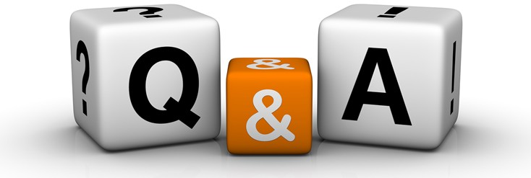
Thanks for your listening

Slide 19
α|0⟩ + β|1⟩
X error
α|0⟩ + β|1⟩
|0⟩
|s_{e}⟩
|0⟩
encode
error
decode

Slide 20
H
Z error
H
α|0⟩ + β|1⟩
α|0⟩ + β|1⟩
|0⟩
H
H
|s_{e}⟩
|0⟩
H
H
encode
error
decode

Slide 21
α|0⟩ + β|1⟩
H
H
α|0⟩ + β|1⟩
e
|0⟩
|0⟩
|0⟩
H
H
|0⟩
|s_{e}⟩
|0⟩
|0⟩
H
H
|0⟩
|0⟩
encode
error
decode

